Slide 1
Advanced Computer Architecture Introduction to Parallel Computing
Akhilesh Kumar Singh

Slide 2
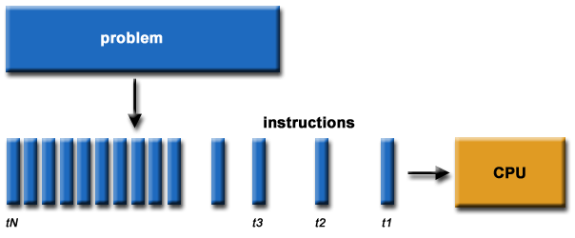
What is Parallel Computing? (1)
Traditionally, software has been written for serial computation:
To be run on a single computer having a single Central Processing Unit (CPU);
A problem is broken into a discrete series of instructions.
Instructions are executed one after another.
Only one instruction may execute at any moment in time.

Slide 3
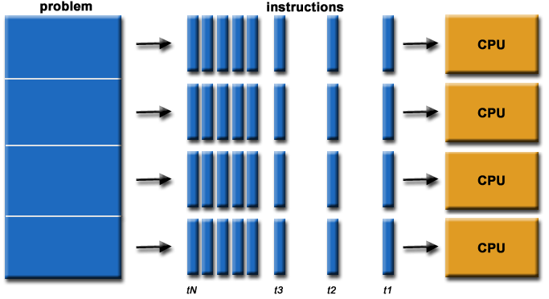
What is Parallel Computing? (2)
In the simplest sense, parallel computing is the simultaneous use of multiple compute resources to solve a computational problem.
To be run using multiple CPUs
A problem is broken into discrete parts that can be solved concurrently
Each part is further broken down to a series of instructions
Instructions from each part execute simultaneously on different CPUs

Slide 4
Parallel Computing: Resources
The compute resources can include:
A single computer with multiple processors;
A single computer with (multiple) processor(s) and some specialized computer resources (GPU, FPGA …)
An arbitrary number of computers connected by a network;
A combination of both.

Slide 5
Parallel Computing: The computational problem
The computational problem usually demonstrates characteristics such as the ability to be:
Broken apart into discrete pieces of work that can be solved simultaneously;
Execute multiple program instructions at any moment in time;
Solved in less time with multiple compute resources than with a single compute resource.

Slide 6
Parallel Computing: what for? (1)
Parallel computing is an evolution of serial computing that attempts to emulate what has always been the state of affairs in the natural world: many complex, interrelated events happening at the same time, yet within a sequence.
Some examples:
Planetary and galactic orbits
Weather and ocean patterns
Tectonic plate drift
Rush hour traffic in Paris
Automobile assembly line
Daily operations within a business
Building a shopping mall
Ordering a hamburger at the drive through.

Slide 7
Parallel Computing: what for? (2)
Traditionally, parallel computing has been considered to be "the high end of computing" and has been motivated by numerical simulations of complex systems and "Grand Challenge Problems" such as:
weather and climate
chemical and nuclear reactions
biological, human genome
geological, seismic activity
mechanical devices - from prosthetics to spacecraft
electronic circuits
manufacturing processes

Slide 8
Parallel Computing: what for? (3)
Today, commercial applications are providing an equal or greater driving force in the development of faster computers. These applications require the processing of large amounts of data in sophisticated ways. Example applications include:
parallel databases, data mining
oil exploration
web search engines, web based business services
computer-aided diagnosis in medicine
management of national and multi-national corporations
advanced graphics and virtual reality, particularly in the entertainment industry
networked video and multi-media technologies
collaborative work environments
Ultimately, parallel computing is an attempt to maximize the infinite but seemingly scarce commodity called time.

Slide 9
Why Parallel Computing? (1)
This is a legitime question! Parallel computing is complex on any aspect!
The primary reasons for using parallel computing:
Save time - wall clock time
Solve larger problems
Provide concurrency (do multiple things at the same time)

Slide 10
Why Parallel Computing? (2)
Other reasons might include:
Taking advantage of non-local resources - using available compute resources on a wide area network, or even the Internet when local compute resources are scarce.
Cost savings - using multiple "cheap" computing resources instead of paying for time on a supercomputer.
Overcoming memory constraints - single computers have very finite memory resources. For large problems, using the memories of multiple computers may overcome this obstacle.

Slide 11
Limitations of Serial Computing
Limits to serial computing - both physical and practical reasons pose significant constraints to simply building ever faster serial computers.
Transmission speeds - the speed of a serial computer is directly dependent upon how fast data can move through hardware. Absolute limits are the speed of light (30 cm/nanosecond) and the transmission limit of copper wire (9 cm/nanosecond). Increasing speeds necessitate increasing proximity of processing elements.
Limits to miniaturization - processor technology is allowing an increasing number of transistors to be placed on a chip. However, even with molecular or atomic-level components, a limit will be reached on how small components can be.
Economic limitations - it is increasingly expensive to make a single processor faster. Using a larger number of moderately fast commodity processors to achieve the same (or better) performance is less expensive.

Slide 12
Concepts and Terminology

Slide 13
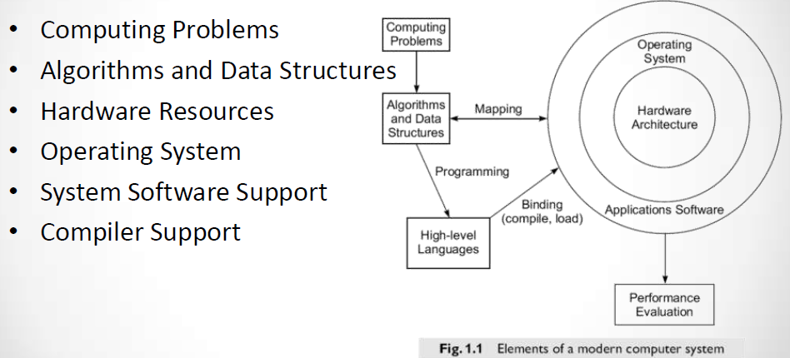
Elements of Modern Computer

Slide 14
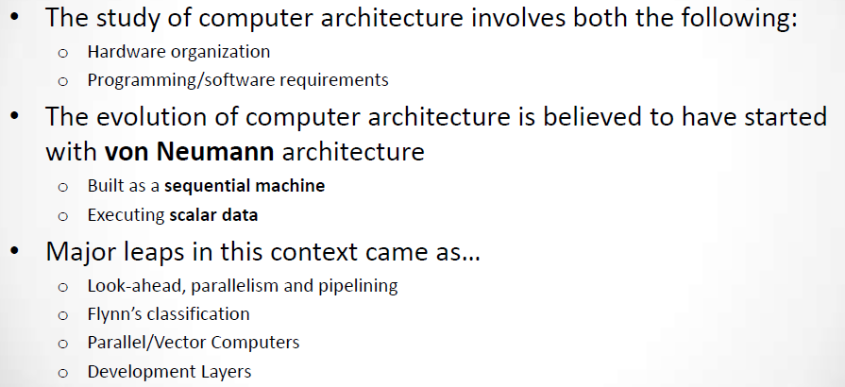
Evolution of Computer Architecture

Slide 15
Von Neumann Architecture
For over 40 years, virtually all computers have followed a common machine model known as the von Neumann computer. Named after the Hungarian mathematician John von Neumann.
A von Neumann computer uses the stored-program concept. The CPU executes a stored program that specifies a sequence of read and write operations on the memory.

Slide 16
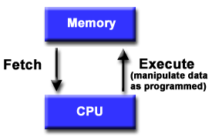
Basic Design
Basic design
Memory is used to store both program and data instructions
Program instructions are coded data which tell the computer to do something
Data is simply information to be used by the program
A central processing unit (CPU) gets instructions and/or data from memory, decodes the instructions and then sequentially performs them.

Slide 17
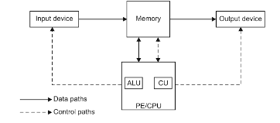
Constraints of conventional architecture
PE receives one instruction of program at a time, interprets it and executes it (Thus operation is serial**)
At a time PE executes one** instruction (Thus the speed of sequential computer depends on the speed on which PE retrieves instruction and at which it process retrieved data.

Slide 18
Constraints of conventional architecture
To increase speed many such sequential computer works together.
Such a computer which consists of number of interconnected sequential computers which cooperatively?? Executes a single program to solve a problem is called parallel computer.

Slide 19
How to maximize CPU Performance
By improving the performance of a single computer [within CPU]
(Uniprocessing/Conventional Approach/ Von Neumann Architecture)
How??
Increase clock rate, using faster memories and caches, pipelining at instruction level.

Slide 20
How to maximize CPU Performance
By parallel processing [with many CPU]
How??
Many CPU are employed (PE)*
Architecture used to solve these problems are known as Advanced Computer Architecture.
Algorithm used here is known as Parallel Algorithm.
Programming of these computer is known as Parallel Programming

Slide 21
Need for parallel computing??
First recall classes of computers-
Low cost/power(Laptop)→ Balanced cost/performance(Workstation/Servers)→ High performance (supercomputers)
Examples??
Several reasons but most important are:-
To save time and cost
To provide concurrency i.e, parallel execution of tasks.

Slide 22
Applications and Requirements
Scientific/numerical: weather prediction, molecular modeling
Need: large memory, floating-point arithmetic
Commercial: inventory, payroll, web serving, e-commerce
Need: integer arithmetic, high I/O
Embedded: automobile engines, microwave, PDAs
Need: low power, low cost, interrupt driven
Home computing: multimedia, games, entertainment
Need: high data bandwidth, graphics

Slide 23
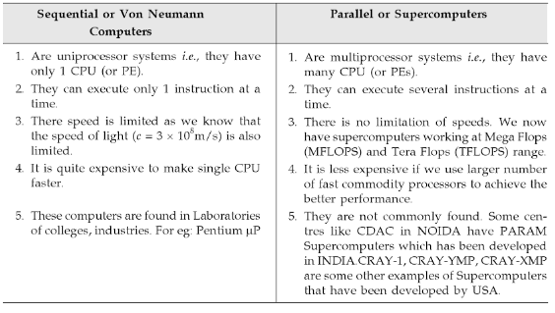
Sequential v/s parallel computers

Slide 24
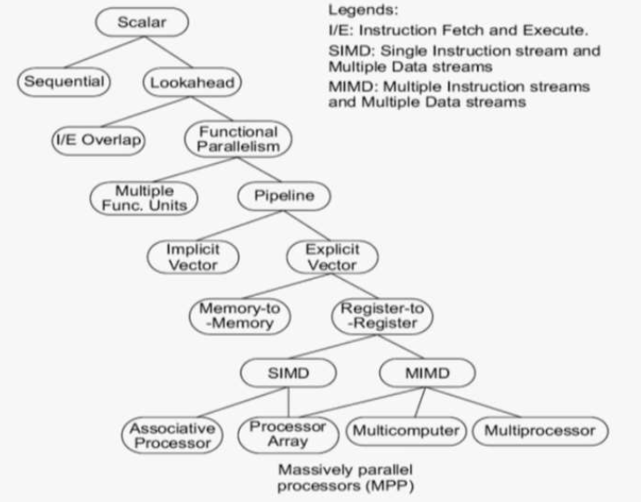
Architecture Evolution

Slide 25
MFLOPS (Mega Flops)
A machine which is capable of performing one floating point operation every 10ns has a speed of (1/10^-8)= 100 mega flops i.e, 100 million (mega) floating point operation per second.

Slide 26
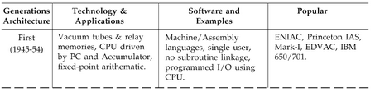
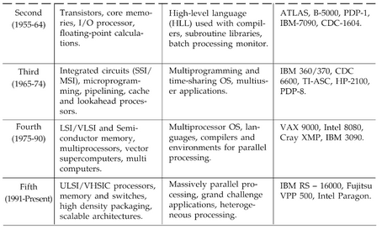
Generations of Computers

Slide 27
Flynn's Classical Taxonomy
There are different ways to classify parallel computers. One of the more widely used classifications, in use since 1966, is called Flynn's Taxonomy.
Flynn's taxonomy distinguishes multi-processor computer architectures according to how they can be classified along the two independent dimensions of Instruction and Data. Each of these dimensions can have only one of two possible states: Single or Multiple.

Slide 28
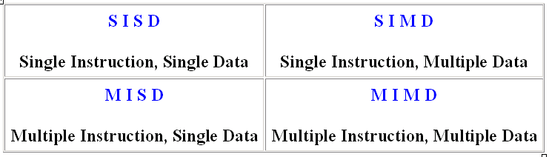
Flynn Matrix
The matrix below defines the 4 possible classifications according to Flynn

Slide 29
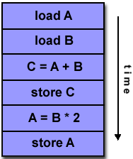
Single Instruction, Single Data (SISD)
A serial (non-parallel) computer
Single instruction: only one instruction stream is being acted on by the CPU during any one clock cycle
Single data: only one data stream is being used as input during any one clock cycle
Deterministic execution
This is the oldest and until recently, the most prevalent form of computer
Examples: most PCs, single CPU workstations and mainframes

Slide 30
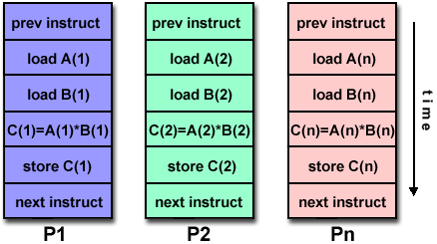
Single Instruction, Multiple Data (SIMD)
A type of parallel computer
Single instruction: All processing units execute the same instruction at any given clock cycle
Multiple data: Each processing unit can operate on a different data element
This type of machine typically has an instruction dispatcher, a very high-bandwidth internal network, and a very large array of very small-capacity instruction units.
Best suited for specialized problems characterized by a high degree of regularity,such as image processing.
Synchronous (lockstep) and deterministic execution
Two varieties: Processor Arrays and Vector Pipelines
Examples:
Processor Arrays: Connection Machine CM-2, Maspar MP-1, MP-2
Vector Pipelines: IBM 9000, Cray C90, Fujitsu VP, NEC SX-2, Hitachi S820

Slide 31
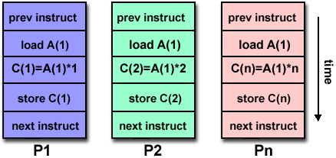
Multiple Instruction, Single Data (MISD)
A single data stream is fed into multiple processing units.
Each processing unit operates on the data independently via independent instruction streams.
Few actual examples of this class of parallel computer have ever existed. One is the experimental Carnegie-Mellon C.mmp computer (1971).
Some conceivable uses might be:
multiple frequency filters operating on a single signal stream
multiple cryptography algorithms attempting to crack a single coded message.

Slide 32
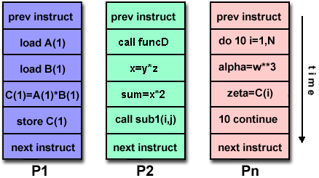
Multiple Instruction, Multiple Data (MIMD)
Currently, the most common type of parallel computer. Most modern computers fall into this category.
Multiple Instruction: every processor may be executing a different instruction stream
Multiple Data: every processor may be working with a different data stream
Execution can be synchronous or asynchronous, deterministic or non-deterministic
Examples: most current supercomputers, networked parallel computer "grids" and multi-processor SMP computers - including some types of PCs.

Slide 33
Some General Parallel Terminology
Like everything else, parallel computing has its own "jargon". Some of the more commonly used terms associated with parallel computing are listed below. Most of these will be discussed in more detail later.
Task
A logically discrete section of computational work. A task is typically a program or program-like set of instructions that is executed by a processor.
Parallel Task
A task that can be executed by multiple processors safely (yields correct results)
Serial Execution
Execution of a program sequentially, one statement at a time. In the simplest sense, this is what happens on a one processor machine. However, virtually all parallel tasks will have sections of a parallel program that must be executed serially.

Slide 34
Parallel Execution
Execution of a program by more than one task, with each task being able to execute the same or different statement at the same moment in time.
Shared Memory
From a strictly hardware point of view, describes a computer architecture where all processors have direct (usually bus based) access to common physical memory. In a programming sense, it describes a model where parallel tasks all have the same "picture" of memory and can directly address and access the same logical memory locations regardless of where the physical memory actually exists.
Distributed Memory
In hardware, refers to network based memory access for physical memory that is not common. As a programming model, tasks can only logically "see" local machine memory and must use communications to access memory on other machines where other tasks are executing.

Slide 35
Communications
Parallel tasks typically need to exchange data. There are several ways this can be accomplished, such as through a shared memory bus or over a network, however the actual event of data exchange is commonly referred to as communications regardless of the method employed.
Synchronization
The coordination of parallel tasks in real time, very often associated with communications. Often implemented by establishing a synchronization point within an application where a task may not proceed further until another task(s) reaches the same or logically equivalent point.
Synchronization usually involves waiting by at least one task, and can therefore cause a parallel application's wall clock execution time to increase.

Slide 36
Granularity
In parallel computing, granularity is a qualitative measure of the ratio of computation to communication.
Coarse: relatively large amounts of computational work are done between communication events
Fine: relatively small amounts of computational work are done between communication events
Observed Speedup
Observed speedup of a code which has been parallelized, defined as:
wall-clock time of serial execution
wall-clock time of parallel execution
One of the simplest and most widely used indicators for a parallel program's performance.

Slide 37
Parallel Overhead
The amount of time required to coordinate parallel tasks, as opposed to doing useful work. Parallel overhead can include factors such as:
Task start-up time
Synchronizations
Data communications
Software overhead imposed by parallel compilers, libraries, tools, operating system, etc.
Task termination time
Massively Parallel
Refers to the hardware that comprises a given parallel system - having many processors. The meaning of many keeps increasing, but currently BG/L pushes this number to 6 digits.

Slide 38
Scalability
Refers to a parallel system's (hardware and/or software) ability to demonstrate a proportionate increase in parallel speedup with the addition of more processors. Factors that contribute to scalability include:
Hardware - particularly memory-cpu bandwidths and network communications
Application algorithm
Parallel overhead related
Characteristics of your specific application and coding

Slide 39
Parallel Computer Memory Architectures

Slide 40
Memory architectures
Shared Memory
Distributed Memory
Hybrid Distributed-Shared Memory

Slide 41
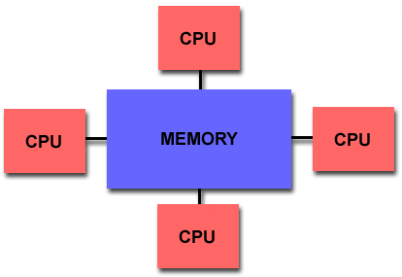
Shared Memory
Shared memory parallel computers vary widely, but generally have in common the ability for all processors to access all memory as global address space.
Multiple processors can operate independently but share the same memory resources.
Changes in a memory location effected by one processor are visible to all other processors.
Shared memory machines can be divided into two main classes based upon memory access times: UMA and NUMA.

Slide 42
Shared Memory : UMA vs. NUMA
Uniform Memory Access (UMA):
Most commonly represented today by Symmetric Multiprocessor (SMP) machines
Identical processors
Equal access and access times to memory
Sometimes called CC-UMA - Cache Coherent UMA. Cache coherent means if one processor updates a location in shared memory, all the other processors know about the update. Cache coherency is accomplished at the hardware level.
Non-Uniform Memory Access (NUMA):
Often made by physically linking two or more SMPs
One SMP can directly access memory of another SMP
Not all processors have equal access time to all memories
Memory access across link is slower
If cache coherency is maintained, then may also be called CC-NUMA - Cache Coherent NUMA

Slide 43
Shared Memory: Pro and Con
Advantages
Global address space provides a user-friendly programming perspective to memory
Data sharing between tasks is both fast and uniform due to the proximity of memory to CPUs
Disadvantages:
Primary disadvantage is the lack of scalability between memory and CPUs. Adding more CPUs can geometrically increases traffic on the shared memory-CPU path, and for cache coherent systems, geometrically increase traffic associated with cache/memory management.
Programmer responsibility for synchronization constructs that insure "correct" access of global memory.
Expense: it becomes increasingly difficult and expensive to design and produce shared memory machines with ever increasing numbers of processors.

Slide 44
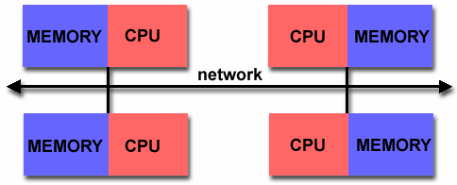
Distributed Memory
Like shared memory systems, distributed memory systems vary widely but share a common characteristic. Distributed memory systems require a communication network to connect inter-processor memory.
Processors have their own local memory. Memory addresses in one processor do not map to another processor, so there is no concept of global address space across all processors.
Because each processor has its own local memory, it operates independently. Changes it makes to its local memory have no effect on the memory of other processors. Hence, the concept of cache coherency does not apply.
When a processor needs access to data in another processor, it is usually the task of the programmer to explicitly define how and when data is communicated. Synchronization between tasks is likewise the programmer's responsibility.
The network "fabric" used for data transfer varies widely, though it can can be as simple as Ethernet.

Slide 45
Distributed Memory: Pro and Con
Advantages
Memory is scalable with number of processors. Increase the number of processors and the size of memory increases proportionately.
Each processor can rapidly access its own memory without interference and without the overhead incurred with trying to maintain cache coherency.
Cost effectiveness: can use commodity, off-the-shelf processors and networking.
Disadvantages
The programmer is responsible for many of the details associated with data communication between processors.
It may be difficult to map existing data structures, based on global memory, to this memory organization.
Non-uniform memory access (NUMA) times

Slide 46
Hybrid Distributed-Shared Memory
Summarizing a few of the key characteristics of shared and distributed memory machines
Comparison of Shared and Distributed Memory Architectures
Architecture | CC-UMA | CC-NUMA | Distributed
Examples | SMPs Sun Vexx DEC/Compaq SGI Challenge IBM POWER3 | Bull NovaScale SGI Origin Sequent HP Exemplar DEC/Compaq IBM POWER4 (MCM) | Cray T3E Maspar IBM SP2 IBM BlueGene
Communications | MPI Threads OpenMP shmem | MPI Threads OpenMP shmem | MPI
Scalability | to 10s of processors | to 100s of processors | to 1000s of processors
Draw Backs | Memory-CPU bandwidth | Memory-CPU bandwidth Non-uniform access times | System administration Programming is hard to develop and maintain
Software Availability | many 1000s ISVs | many 1000s ISVs | 100s ISVs

Slide 47
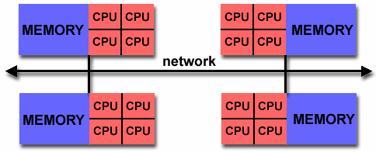
Hybrid Distributed-Shared Memory
The largest and fastest computers in the world today employ both shared and distributed memory architectures.
The shared memory component is usually a cache coherent SMP machine. Processors on a given SMP can address that machine's memory as global.
The distributed memory component is the networking of multiple SMPs. SMPs know only about their own memory - not the memory on another SMP. Therefore, network communications are required to move data from one SMP to another.
Current trends seem to indicate that this type of memory architecture will continue to prevail and increase at the high end of computing for the foreseeable future.
Advantages and Disadvantages: whatever is common to both shared and distributed memory architectures.

Slide 48
Parallel Programming Models

Slide 49
Overview
Shared Memory Model
Threads Model
Message Passing Model
Data Parallel Model
Other Models

Slide 50
Overview
There are several parallel programming models in common use:
Shared Memory
Threads
Message Passing
Data Parallel
Hybrid
Parallel programming models exist as an abstraction above hardware and memory architectures.

Slide 51
Overview
Although it might not seem apparent, these models are NOT specific to a particular type of machine or memory architecture. In fact, any of these models can (theoretically) be implemented on any underlying hardware.
Shared memory model on a distributed memory machine: Kendall Square Research (KSR) ALLCACHE approach.
Machine memory was physically distributed, but appeared to the user as a single shared memory (global address space). Generically, this approach is referred to as "virtual shared memory".
Note: although KSR is no longer in business, there is no reason to suggest that a similar implementation will not be made available by another vendor in the future.
Message passing model on a shared memory machine: MPI on SGI Origin.
The SGI Origin employed the CC-NUMA type of shared memory architecture, where every task has direct access to global memory. However, the ability to send and receive messages with MPI, as is commonly done over a network of distributed memory machines, is not only implemented but is very commonly used.

Slide 52
Overview
Which model to use is often a combination of what is available and personal choice. There is no "best" model, although there certainly are better implementations of some models over others.
The following sections describe each of the models mentioned above, and also discuss some of their actual implementations.

Slide 53
Shared Memory Model
In the shared-memory programming model, tasks share a common address space, which they read and write asynchronously.
Various mechanisms such as locks / semaphores may be used to control access to the shared memory.
An advantage of this model from the programmer's point of view is that the notion of data "ownership" is lacking, so there is no need to specify explicitly the communication of data between tasks. Program development can often be simplified.
An important disadvantage in terms of performance is that it becomes more difficult to understand and manage data locality.

Slide 54
Shared Memory Model: Implementations
On shared memory platforms, the native compilers translate user program variables into actual memory addresses, which are global.
No common distributed memory platform implementations currently exist. However, as mentioned previously in the Overview section, the KSR ALLCACHE approach provided a shared memory view of data even though the physical memory of the machine was distributed.

Slide 55
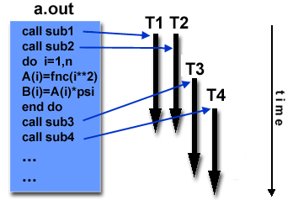
Threads Model
In the threads model of parallel programming, a single process can have multiple, concurrent execution paths.
Perhaps the most simple analogy that can be used to describe threads is the concept of a single program that includes a number of subroutines:
The main program a.out is scheduled to run by the native operating system. a.out loads and acquires all of the necessary system and user resources to run.
a.out performs some serial work, and then creates a number of tasks (threads) that can be scheduled and run by the operating system concurrently.
Each thread has local data, but also, shares the entire resources of a.out. This saves the overhead associated with replicating a program's resources for each thread. Each thread also benefits from a global memory view because it shares the memory space of a.out.
A thread's work may best be described as a subroutine within the main program. Any thread can execute any subroutine at the same time as other threads.
Threads communicate with each other through global memory (updating address locations). This requires synchronization constructs to insure that more than one thread is not updating the same global address at any time.
Threads can come and go, but a.out remains present to provide the necessary shared resources until the application has completed.
Threads are commonly associated with shared memory architectures and operating systems.

Slide 56
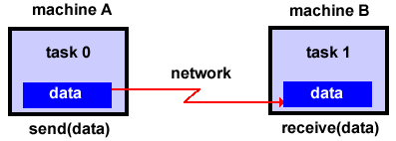
Threads Model Implementations
From a programming perspective, threads implementations commonly comprise:
A library of subroutines that are called from within parallel source code
A set of compiler directives imbedded in either serial or parallel source code
In both cases, the programmer is responsible for determining all parallelism.
Threaded implementations are not new in computing. Historically, hardware vendors have implemented their own proprietary versions of threads. These implementations differed substantially from each other making it difficult for programmers to develop portable threaded applications.
Unrelated standardization efforts have resulted in two very different implementations of threads: POSIX Threads and OpenMP.
POSIX Threads
Library based; requires parallel coding
Specified by the IEEE POSIX 1003.1c standard (1995).
C Language only
Commonly referred to as Pthreads.
Most hardware vendors now offer Pthreads in addition to their proprietary threads implementations.
Very explicit parallelism; requires significant programmer attention to detail.

Slide 57
Threads Model: OpenMP
OpenMP
Compiler directive based; can use serial code
Jointly defined and endorsed by a group of major computer hardware and software vendors. The OpenMP Fortran API was released October 28, 1997. The C/C++ API was released in late 1998.
Portable / multi-platform, including Unix and Windows NT platforms
Available in C/C++ and Fortran implementations
Can be very easy and simple to use - provides for "incremental parallelism"
Microsoft has its own implementation for threads, which is not related to the UNIX POSIX standard or OpenMP.

Slide 58
Message Passing Model
The message passing model demonstrates the following characteristics:
A set of tasks that use their own local memory during computation. Multiple tasks can reside on the same physical machine as well across an arbitrary number of machines.
Tasks exchange data through communications by sending and receiving messages.
Data transfer usually requires cooperative operations to be performed by each process. For example, a send operation must have a matching receive operation.

Slide 59
Message Passing Model Implementations: MPI
From a programming perspective, message passing implementations commonly comprise a library of subroutines that are imbedded in source code. The programmer is responsible for determining all parallelism.
Historically, a variety of message passing libraries have been available since the 1980s. These implementations differed substantially from each other making it difficult for programmers to develop portable applications.
In 1992, the MPI Forum was formed with the primary goal of establishing a standard interface for message passing implementations.
Part 1 of the Message Passing Interface (MPI) was released in 1994. Part 2 (MPI-2) was released in 1996. Both MPI specifications are available on the web at www.mcs.anl.gov/Projects/mpi/standard.html.

Slide 60
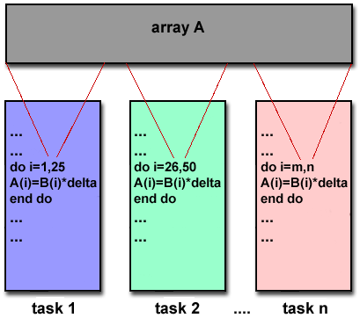
Message Passing Model Implementations: MPI
MPI is now the "de facto" industry standard for message passing, replacing virtually all other message passing implementations used for production work. Most, if not all of the popular parallel computing platforms offer at least one implementation of MPI. A few offer a full implementation of MPI-2.
For shared memory architectures, MPI implementations usually don't use a network for task communications. Instead, they use shared memory (memory copies) for performance reasons.

Slide 61
Data Parallel Model
The data parallel model demonstrates the following characteristics:
Most of the parallel work focuses on performing operations on a data set. The data set is typically organized into a common structure, such as an array or cube.
A set of tasks work collectively on the same data structure, however, each task works on a different partition of the same data structure.
Tasks perform the same operation on their partition of work, for example, "add 4 to every array element".
On shared memory architectures, all tasks may have access to the data structure through global memory. On distributed memory architectures the data structure is split up and resides as "chunks" in the local memory of each task.

Slide 62
Data Parallel Model Implementations
Programming with the data parallel model is usually accomplished by writing a program with data parallel constructs. The constructs can be calls to a data parallel subroutine library or, compiler directives recognized by a data parallel compiler.
Fortran 90 and 95 (F90, F95): ISO/ANSI standard extensions to Fortran 77.
Contains everything that is in Fortran 77
New source code format; additions to character set
Additions to program structure and commands
Variable additions - methods and arguments
Pointers and dynamic memory allocation added
Array processing (arrays treated as objects) added
Recursive and new intrinsic functions added
Many other new features
Implementations are available for most common parallel platforms.

Slide 63
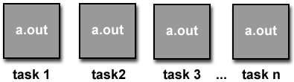
Data Parallel Model Implementations
High Performance Fortran (HPF): Extensions to Fortran 90 to support data parallel programming.
Contains everything in Fortran 90
Directives to tell compiler how to distribute data added
Assertions that can improve optimization of generated code added
Data parallel constructs added (now part of Fortran 95)
Implementations are available for most common parallel platforms.
Compiler Directives: Allow the programmer to specify the distribution and alignment of data. Fortran implementations are available for most common parallel platforms.
Distributed memory implementations of this model usually have the compiler convert the program into standard code with calls to a message passing library (MPI usually) to distribute the data to all the processes. All message passing is done invisibly to the programmer.

Slide 64
Other Models
Other parallel programming models besides those previously mentioned certainly exist, and will continue to evolve along with the ever changing world of computer hardware and software.
Only three of the more common ones are mentioned here.
Hybrid
Single Program Multiple Data
Multiple Program Multiple Data

Slide 65
Hybryd
In this model, any two or more parallel programming models are combined.
Currently, a common example of a hybrid model is the combination of the message passing model (MPI) with either the threads model (POSIX threads) or the shared memory model (OpenMP). This hybrid model lends itself well to the increasingly common hardware environment of networked SMP machines.
Another common example of a hybrid model is combining data parallel with message passing. As mentioned in the data parallel model section previously, data parallel implementations (F90, HPF) on distributed memory architectures actually use message passing to transmit data between tasks, transparently to the programmer.

Slide 66
Single Program Multiple Data (SPMD)
Single Program Multiple Data (SPMD):
SPMD is actually a "high level" programming model that can be built upon any combination of the previously mentioned parallel programming models.
A single program is executed by all tasks simultaneously.
At any moment in time, tasks can be executing the same or different instructions within the same program.
SPMD programs usually have the necessary logic programmed into them to allow different tasks to branch or conditionally execute only those parts of the program they are designed to execute. That is, tasks do not necessarily have to execute the entire program - perhaps only a portion of it.
All tasks may use different data

Slide 67
Multiple Program Multiple Data (MPMD)
Multiple Program Multiple Data (MPMD):
Like SPMD, MPMD is actually a "high level" programming model that can be built upon any combination of the previously mentioned parallel programming models.
MPMD applications typically have multiple executable object files (programs). While the application is being run in parallel, each task can be executing the same or different program as other tasks.
All tasks may use different data

Slide 68
Designing Parallel Programs

Slide 69
Agenda
Automatic vs. Manual Parallelization
Understand the Problem and the Program
Partitioning
Communications
Synchronization
Data Dependencies
Load Balancing
Granularity
I/O
Limits and Costs of Parallel Programming
Performance Analysis and Tuning

Slide 70
Agenda
Automatic vs. Manual Parallelization
Understand the Problem and the Program
Partitioning
Communications
Synchronization
Data Dependencies
Load Balancing
Granularity
I/O
Limits and Costs of Parallel Programming
Performance Analysis and Tuning

Slide 71
Designing and developing parallel programs has characteristically been a very manual process. The programmer is typically responsible for both identifying and actually implementing parallelism.
Very often, manually developing parallel codes is a time consuming, complex, error-prone and iterative process.
For a number of years now, various tools have been available to assist the programmer with converting serial programs into parallel programs. The most common type of tool used to automatically parallelize a serial program is a parallelizing compiler or pre-processor.

Slide 72
A parallelizing compiler generally works in two different ways:
Fully Automatic
The compiler analyzes the source code and identifies opportunities for parallelism.
The analysis includes identifying inhibitors to parallelism and possibly a cost weighting on whether or not the parallelism would actually improve performance.
Loops (do, for) loops are the most frequent target for automatic parallelization.
Programmer Directed
Using "compiler directives" or possibly compiler flags, the programmer explicitly tells the compiler how to parallelize the code.
May be able to be used in conjunction with some degree of automatic parallelization also.

Slide 73
If you are beginning with an existing serial code and have time or budget constraints, then automatic parallelization may be the answer. However, there are several important caveats that apply to automatic parallelization:
Wrong results may be produced
Performance may actually degrade
Much less flexible than manual parallelization
Limited to a subset (mostly loops) of code
May actually not parallelize code if the analysis suggests there are inhibitors or the code is too complex
Most automatic parallelization tools are for Fortran
The remainder of this section applies to the manual method of developing parallel codes.

Slide 74
Agenda
Automatic vs. Manual Parallelization
Understand the Problem and the Program
Partitioning
Communications
Synchronization
Data Dependencies
Load Balancing
Granularity
I/O
Limits and Costs of Parallel Programming
Performance Analysis and Tuning

Slide 75
Undoubtedly, the first step in developing parallel software is to first understand the problem that you wish to solve in parallel. If you are starting with a serial program, this necessitates understanding the existing code also.
Before spending time in an attempt to develop a parallel solution for a problem, determine whether or not the problem is one that can actually be parallelized.

Slide 76
Example of Parallelizable Problem
Calculate the potential energy for each of several thousand independent conformations of a molecule. When done, find the minimum energy conformation.
This problem is able to be solved in parallel. Each of the molecular conformations is independently determinable. The calculation of the minimum energy conformation is also a parallelizable problem.

Slide 77
Example of a Non-parallelizable Problem
Calculation of the Fibonacci series (1,1,2,3,5,8,13,21,...) by use of the formula:
F(k + 2) = F(k + 1) + F(k)
This is a non-parallelizable problem because the calculation of the Fibonacci sequence as shown would entail dependent calculations rather than independent ones. The calculation of the k + 2 value uses those of both k + 1 and k. These three terms cannot be calculated independently and therefore, not in parallel.

Slide 78
Identify the program's hotspots
Know where most of the real work is being done. The majority of scientific and technical programs usually accomplish most of their work in a few places.
Profilers and performance analysis tools can help here
Focus on parallelizing the hotspots and ignore those sections of the program that account for little CPU usage.

Slide 79
Identify bottlenecks in the program
Are there areas that are disproportionately slow, or cause parallelizable work to halt or be deferred? For example, I/O is usually something that slows a program down.
May be possible to restructure the program or use a different algorithm to reduce or eliminate unnecessary slow areas

Slide 80
Other considerations
Identify inhibitors to parallelism. One common class of inhibitor is data dependence, as demonstrated by the Fibonacci sequence above.
Investigate other algorithms if possible. This may be the single most important consideration when designing a parallel application.

Slide 81
Agenda
Automatic vs. Manual Parallelization
Understand the Problem and the Program
Partitioning
Communications
Synchronization
Data Dependencies
Load Balancing
Granularity
I/O
Limits and Costs of Parallel Programming
Performance Analysis and Tuning

Slide 82
One of the first steps in designing a parallel program is to break the problem into discrete "chunks" of work that can be distributed to multiple tasks. This is known as decomposition or partitioning.
There are two basic ways to partition computational work among parallel tasks:
domain decomposition and
functional decomposition

Slide 83
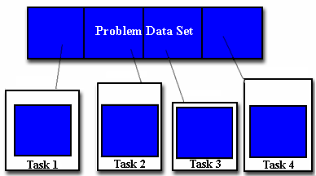
Domain Decomposition
In this type of partitioning, the data associated with a problem is decomposed. Each parallel task then works on a portion of of the data.

Slide 84
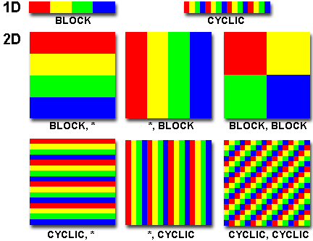
Partitioning Data
There are different ways to partition data

Slide 85
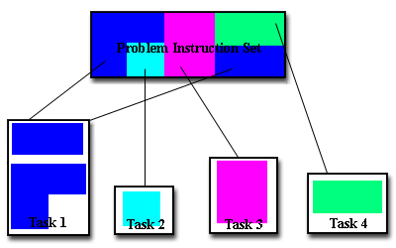
Functional Decomposition
In this approach, the focus is on the computation that is to be performed rather than on the data manipulated by the computation. The problem is decomposed according to the work that must be done. Each task then performs a portion of the overall work.
Functional decomposition lends itself well to problems that can be split into different tasks. For example
Ecosystem Modeling
Signal Processing
Climate Modeling

Slide 86
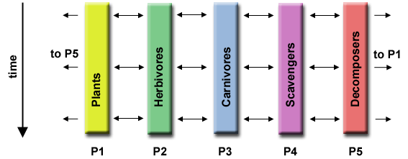
Ecosystem Modeling
Each program calculates the population of a given group, where each group's growth depends on that of its neighbors. As time progresses, each process calculates its current state, then exchanges information with the neighbor populations. All tasks then progress to calculate the state at the next time step.

Slide 87
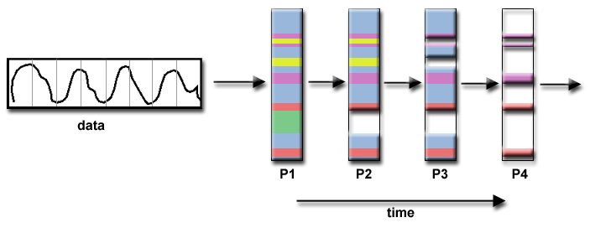
Signal Processing
An audio signal data set is passed through four distinct computational filters. Each filter is a separate process. The first segment of data must pass through the first filter before progressing to the second. When it does, the second segment of data passes through the first filter. By the time the fourth segment of data is in the first filter, all four tasks are busy.

Slide 88
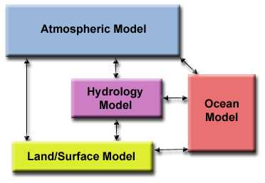
Climate Modeling
Each model component can be thought of as a separate task. Arrows represent exchanges of data between components during computation: the atmosphere model generates wind velocity data that are used by the ocean model, the ocean model generates sea surface temperature data that are used by the atmosphere model, and so on.
Combining these two types of problem decomposition is common and natural.

Slide 89
Agenda
Automatic vs. Manual Parallelization
Understand the Problem and the Program
Partitioning
Communications
Synchronization
Data Dependencies
Load Balancing
Granularity
I/O
Limits and Costs of Parallel Programming
Performance Analysis and Tuning

Slide 90
Who Needs Communications?
The need for communications between tasks depends upon your problem
You DON'T need communications
Some types of problems can be decomposed and executed in parallel with virtually no need for tasks to share data. For example, imagine an image processing operation where every pixel in a black and white image needs to have its color reversed. The image data can easily be distributed to multiple tasks that then act independently of each other to do their portion of the work.
These types of problems are often called embarrassingly parallel because they are so straight-forward. Very little inter-task communication is required.
You DO need communications
Most parallel applications are not quite so simple, and do require tasks to share data with each other. For example, a 3-D heat diffusion problem requires a task to know the temperatures calculated by the tasks that have neighboring data. Changes to neighboring data has a direct effect on that task's data.

Slide 91
Factors to Consider (1)
There are a number of important factors to consider when designing your program's inter-task communications
Cost of communications
Inter-task communication virtually always implies overhead.
Machine cycles and resources that could be used for computation are instead used to package and transmit data.
Communications frequently require some type of synchronization between tasks, which can result in tasks spending time "waiting" instead of doing work.
Competing communication traffic can saturate the available network bandwidth, further aggravating performance problems.

Slide 92
Factors to Consider (2)
Latency vs. Bandwidth
latency is the time it takes to send a minimal (0 byte) message from point A to point B. Commonly expressed as microseconds.
bandwidth is the amount of data that can be communicated per unit of time. Commonly expressed as megabytes/sec.
Sending many small messages can cause latency to dominate communication overheads. Often it is more efficient to package small messages into a larger message, thus increasing the effective communications bandwidth.

Slide 93
Factors to Consider (3)
Visibility of communications
With the Message Passing Model, communications are explicit and generally quite visible and under the control of the programmer.
With the Data Parallel Model, communications often occur transparently to the programmer, particularly on distributed memory architectures. The programmer may not even be able to know exactly how inter-task communications are being accomplished.

Slide 94
Factors to Consider (4)
Synchronous vs. asynchronous communications
Synchronous communications require some type of "handshaking" between tasks that are sharing data. This can be explicitly structured in code by the programmer, or it may happen at a lower level unknown to the programmer.
Synchronous communications are often referred to as blocking communications since other work must wait until the communications have completed.
Asynchronous communications allow tasks to transfer data independently from one another. For example, task 1 can prepare and send a message to task 2, and then immediately begin doing other work. When task 2 actually receives the data doesn't matter.
Asynchronous communications are often referred to as non-blocking communications since other work can be done while the communications are taking place.
Interleaving computation with communication is the single greatest benefit for using asynchronous communications.

Slide 95
Factors to Consider (5)
Scope of communications
Knowing which tasks must communicate with each other is critical during the design stage of a parallel code. Both of the two scopings described below can be implemented synchronously or asynchronously.
Point-to-point - involves two tasks with one task acting as the sender/producer of data, and the other acting as the receiver/consumer.
Collective - involves data sharing between more than two tasks, which are often specified as being members in a common group, or collective.

Slide 96
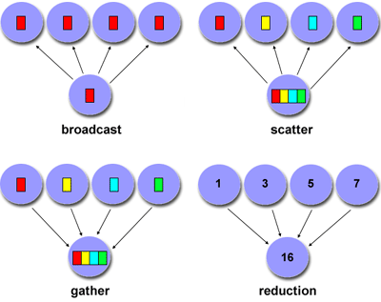
Collective Communications
Examples

Slide 97
Factors to Consider (6)
Efficiency of communications
Very often, the programmer will have a choice with regard to factors that can affect communications performance. Only a few are mentioned here.
Which implementation for a given model should be used? Using the Message Passing Model as an example, one MPI implementation may be faster on a given hardware platform than another.
What type of communication operations should be used? As mentioned previously, asynchronous communication operations can improve overall program performance.
Network media - some platforms may offer more than one network for communications. Which one is best?

Slide 98
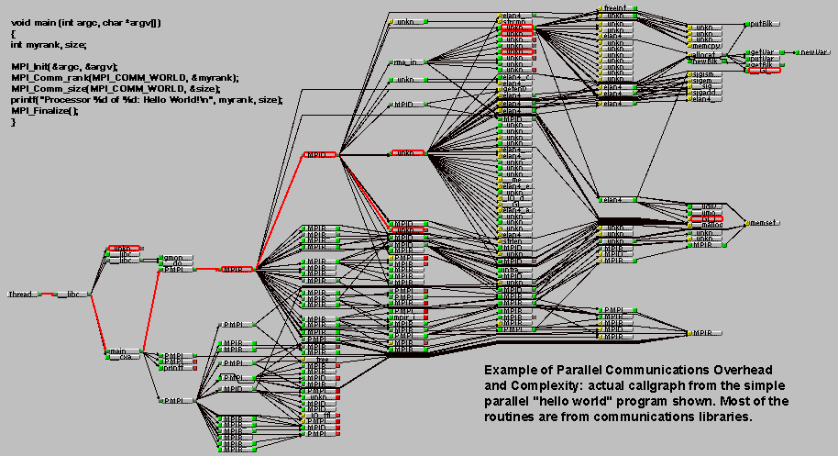
Factors to Consider (7)
Overhead and Complexity

Slide 99
Factors to Consider (8)
Finally, realize that this is only a partial list of things to consider!!!

Slide 100
Agenda
Automatic vs. Manual Parallelization
Understand the Problem and the Program
Partitioning
Communications
Synchronization
Data Dependencies
Load Balancing
Granularity
I/O
Limits and Costs of Parallel Programming
Performance Analysis and Tuning

Slide 101
Types of Synchronization
Barrier
Usually implies that all tasks are involved
Each task performs its work until it reaches the barrier. It then stops, or "blocks".
When the last task reaches the barrier, all tasks are synchronized.
What happens from here varies. Often, a serial section of work must be done. In other cases, the tasks are automatically released to continue their work.
Lock / semaphore
Can involve any number of tasks
Typically used to serialize (protect) access to global data or a section of code. Only one task at a time may use (own) the lock / semaphore / flag.
The first task to acquire the lock "sets" it. This task can then safely (serially) access the protected data or code.
Other tasks can attempt to acquire the lock but must wait until the task that owns the lock releases it.
Can be blocking or non-blocking
Synchronous communication operations
Involves only those tasks executing a communication operation
When a task performs a communication operation, some form of coordination is required with the other task(s) participating in the communication. For example, before a task can perform a send operation, it must first receive an acknowledgment from the receiving task that it is OK to send.
Discussed previously in the Communications section.

Slide 102
Agenda
Automatic vs. Manual Parallelization
Understand the Problem and the Program
Partitioning
Communications
Synchronization
Data Dependencies
Load Balancing
Granularity
I/O
Limits and Costs of Parallel Programming
Performance Analysis and Tuning

Slide 103
Definitions
A dependence exists between program statements when the order of statement execution affects the results of the program.
A data dependence results from multiple use of the same location(s) in storage by different tasks.
Dependencies are important to parallel programming because they are one of the primary inhibitors to parallelism.

Slide 104
Examples (1): Loop carried data dependence
DO 500 J = MYSTART,MYEND
A(J) = A(J-1) * 2.0500
CONTINUE
The value of A(J-1) must be computed before the value of A(J), therefore A(J) exhibits a data dependency on A(J-1). Parallelism is inhibited.
If Task 2 has A(J) and task 1 has A(J-1), computing the correct value of A(J) necessitates:
Distributed memory architecture - task 2 must obtain the value of A(J-1) from task 1 after task 1 finishes its computation
Shared memory architecture - task 2 must read A(J-1) after task 1 updates it

Slide 105
Examples (2): Loop independent data dependence
task 1 task 2
------ ------
X = 2 X = 4
. .
. .
Y = X**2 Y = X**3
As with the previous example, parallelism is inhibited. The value of Y is dependent on:
Distributed memory architecture - if or when the value of X is communicated between the tasks.
Shared memory architecture - which task last stores the value of X.
Although all data dependencies are important to identify when designing parallel programs, loop carried dependencies are particularly important since loops are possibly the most common target of parallelization efforts.

Slide 106
How to Handle Data Dependencies?
Distributed memory architectures - communicate required data at synchronization points.
Shared memory architectures -synchronize read/write operations between tasks.

Slide 107
Agenda
Automatic vs. Manual Parallelization
Understand the Problem and the Program
Partitioning
Communications
Synchronization
Data Dependencies
Load Balancing
Granularity
I/O
Limits and Costs of Parallel Programming
Performance Analysis and Tuning

Slide 108
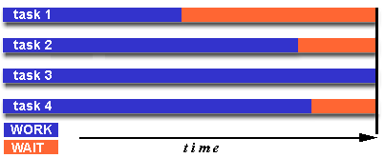
Definition
Load balancing refers to the practice of distributing work among tasks so that all tasks are kept busy all of the time. It can be considered a minimization of task idle time.
Load balancing is important to parallel programs for performance reasons. For example, if all tasks are subject to a barrier synchronization point, the slowest task will determine the overall performance.

Slide 109
How to Achieve Load Balance? (1)
Equally partition the work each task receives
For array/matrix operations where each task performs similar work, evenly distribute the data set among the tasks.
For loop iterations where the work done in each iteration is similar, evenly distribute the iterations across the tasks.
If a heterogeneous mix of machines with varying performance characteristics are being used, be sure to use some type of performance analysis tool to detect any load imbalances. Adjust work accordingly.

Slide 110
How to Achieve Load Balance? (2)
Use dynamic work assignment
Certain classes of problems result in load imbalances even if data is evenly distributed among tasks:
Sparse arrays - some tasks will have actual data to work on while others have mostly "zeros".
Adaptive grid methods - some tasks may need to refine their mesh while others don't.
N-body simulations - where some particles may migrate to/from their original task domain to another task's; where the particles owned by some tasks require more work than those owned by other tasks.
When the amount of work each task will perform is intentionally variable, or is unable to be predicted, it may be helpful to use a scheduler - task pool approach. As each task finishes its work, it queues to get a new piece of work.
It may become necessary to design an algorithm which detects and handles load imbalances as they occur dynamically within the code.

Slide 111
Agenda
Automatic vs. Manual Parallelization
Understand the Problem and the Program
Partitioning
Communications
Synchronization
Data Dependencies
Load Balancing
Granularity
I/O
Limits and Costs of Parallel Programming
Performance Analysis and Tuning

Slide 112
Definitions
Computation / Communication Ratio:
In parallel computing, granularity is a qualitative measure of the ratio of computation to communication.
Periods of computation are typically separated from periods of communication by synchronization events.
Fine grain parallelism
Coarse grain parallelism

Slide 113
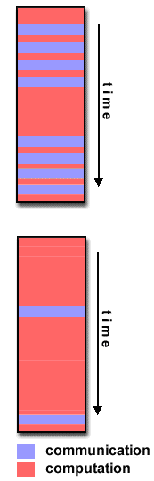
Fine-grain Parallelism
Relatively small amounts of computational work are done between communication events
Low computation to communication ratio
Facilitates load balancing
Implies high communication overhead and less opportunity for performance enhancement
If granularity is too fine it is possible that the overhead required for communications and synchronization between tasks takes longer than the computation.

Slide 114
Coarse-grain Parallelism
Relatively large amounts of computational work are done between communication/synchronization events
High computation to communication ratio
Implies more opportunity for performance increase
Harder to load balance efficiently

Slide 115
Which is Best?
The most efficient granularity is dependent on the algorithm and the hardware environment in which it runs.
In most cases the overhead associated with communications and synchronization is high relative to execution speed so it is advantageous to have coarse granularity.
Fine-grain parallelism can help reduce overheads due to load imbalance.

Slide 116
Agenda
Automatic vs. Manual Parallelization
Understand the Problem and the Program
Partitioning
Communications
Synchronization
Data Dependencies
Load Balancing
Granularity
I/O
Limits and Costs of Parallel Programming
Performance Analysis and Tuning

Slide 117
The bad News
I/O operations are generally regarded as inhibitors to parallelism
Parallel I/O systems are immature or not available for all platforms
In an environment where all tasks see the same filespace, write operations will result in file overwriting
Read operations will be affected by the fileserver's ability to handle multiple read requests at the same time
I/O that must be conducted over the network (NFS, non-local) can cause severe bottlenecks

Slide 118
The good News
Some parallel file systems are available. For example:
GPFS: General Parallel File System for AIX (IBM)
Lustre: for Linux clusters (Cluster File Systems, Inc.)
PVFS/PVFS2: Parallel Virtual File System for Linux clusters (Clemson/Argonne/Ohio State/others)
PanFS: Panasas ActiveScale File System for Linux clusters (Panasas, Inc.)
HP SFS: HP StorageWorks Scalable File Share. Lustre based parallel file system (Global File System for Linux) product from HP
The parallel I/O programming interface specification for MPI has been available since 1996 as part of MPI-2. Vendor and "free" implementations are now commonly available.

Slide 119
Some Options
If you have access to a parallel file system, investigate using it. If you don't, keep reading...
Rule #1: Reduce overall I/O as much as possible
Confine I/O to specific serial portions of the job, and then use parallel communications to distribute data to parallel tasks. For example, Task 1 could read an input file and then communicate required data to other tasks. Likewise, Task 1 could perform write operation after receiving required data from all other tasks.
For distributed memory systems with shared filespace, perform I/O in local, non-shared filespace. For example, each processor may have /tmp filespace which can used. This is usually much more efficient than performing I/O over the network to one's home directory.
Create unique filenames for each tasks' input/output file(s)

Slide 120
Agenda
Automatic vs. Manual Parallelization
Understand the Problem and the Program
Partitioning
Communications
Synchronization
Data Dependencies
Load Balancing
Granularity
I/O
Limits and Costs of Parallel Programming
Performance Analysis and Tuning

Slide 121
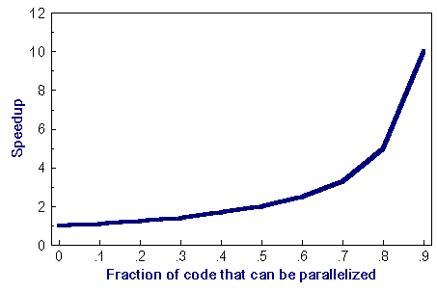
Amdahl's Law
Amdahl's Law states that potential program speedup is defined by the fraction of code (P) that can be parallelized:
1
speedup = --------
1 - P
If none of the code can be parallelized, P = 0 and the speedup = 1 (no speedup). If all of the code is parallelized, P = 1 and the speedup is infinite (in theory).
If 50% of the code can be parallelized, maximum speedup = 2, meaning the code will run twice as fast.

Slide 122
Amdahl's Law
Introducing the number of processors performing the parallel fraction of work, the relationship can be modeled by
where P = parallel fraction, N = number of processors and S = serial fraction
1
speedup = ------------
P + S
---
N

Slide 123
Amdahl's Law
It soon becomes obvious that there are limits to the scalability of parallelism. For example, at P = .50, .90 and .99 (50%, 90% and 99% of the code is parallelizable)
speedup
--------------------------------
N P = .50 P = .90 P = .99
----- ------- ------- -------
10 1.82 5.26 9.17
100 1.98 9.17 50.25
1000 1.99 9.91 90.99
10000 1.99 9.91 99.02

Slide 124
Amdahl's Law
However, certain problems demonstrate increased performance by increasing the problem size. For example:
2D Grid Calculations 85 seconds 85%
Serial fraction 15 seconds 15%
We can increase the problem size by doubling the grid dimensions and halving the time step. This results in four times the number of grid points and twice the number of time steps. The timings then look like:
2D Grid Calculations 680 seconds 97.84%
Serial fraction 15 seconds 2.16%
Problems that increase the percentage of parallel time with their size are more scalable than problems with a fixed percentage of parallel time.

Slide 125
Complexity
In general, parallel applications are much more complex than corresponding serial applications, perhaps an order of magnitude. Not only do you have multiple instruction streams executing at the same time, but you also have data flowing between them.
The costs of complexity are measured in programmer time in virtually every aspect of the software development cycle:
Design
Coding
Debugging
Tuning
Maintenance
Adhering to "good" software development practices is essential when when working with parallel applications - especially if somebody besides you will have to work with the software.

Slide 126
Portability
Thanks to standardization in several APIs, such as MPI, POSIX threads, HPF and OpenMP, portability issues with parallel programs are not as serious as in years past. However...
All of the usual portability issues associated with serial programs apply to parallel programs. For example, if you use vendor "enhancements" to Fortran, C or C++, portability will be a problem.
Even though standards exist for several APIs, implementations will differ in a number of details, sometimes to the point of requiring code modifications in order to effect portability.
Operating systems can play a key role in code portability issues.
Hardware architectures are characteristically highly variable and can affect portability.

Slide 127
Resource Requirements
The primary intent of parallel programming is to decrease execution wall clock time, however in order to accomplish this, more CPU time is required. For example, a parallel code that runs in 1 hour on 8 processors actually uses 8 hours of CPU time.
The amount of memory required can be greater for parallel codes than serial codes, due to the need to replicate data and for overheads associated with parallel support libraries and subsystems.
For short running parallel programs, there can actually be a decrease in performance compared to a similar serial implementation. The overhead costs associated with setting up the parallel environment, task creation, communications and task termination can comprise a significant portion of the total execution time for short runs.

Slide 128
Scalability
The ability of a parallel program's performance to scale is a result of a number of interrelated factors. Simply adding more machines is rarely the answer.
The algorithm may have inherent limits to scalability. At some point, adding more resources causes performance to decrease. Most parallel solutions demonstrate this characteristic at some point.
Hardware factors play a significant role in scalability. Examples:
Memory-cpu bus bandwidth on an SMP machine
Communications network bandwidth
Amount of memory available on any given machine or set of machines
Processor clock speed
Parallel support libraries and subsystems software can limit scalability independent of your application.

Slide 129
Agenda
Automatic vs. Manual Parallelization
Understand the Problem and the Program
Partitioning
Communications
Synchronization
Data Dependencies
Load Balancing
Granularity
I/O
Limits and Costs of Parallel Programming
Performance Analysis and Tuning

Slide 130
As with debugging, monitoring and analyzing parallel program execution is significantly more of a challenge than for serial programs.
A number of parallel tools for execution monitoring and program analysis are available.
Some are quite useful; some are cross-platform also.
One starting point: Performance Analysis Tools Tutorial
Work remains to be done, particularly in the area of scalability.

Slide 131
Parallel Examples

Slide 132
Agenda
Array Processing
PI Calculation
Simple Heat Equation
1-D Wave Equation

Slide 133
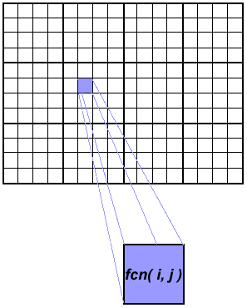
Array Processing
This example demonstrates calculations on 2-dimensional array elements, with the computation on each array element being independent from other array elements.
The serial program calculates one element at a time in sequential order.
Serial code could be of the form:
do j = 1,n
do i = 1,n
a(i,j) = fcn(i,j)
end do
end do
The calculation of elements is independent of one another - leads to an embarrassingly parallel situation.
The problem should be computationally intensive.

Slide 134
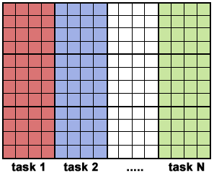
Array Processing Solution 1
Arrays elements are distributed so that each processor owns a portion of an array (subarray).
Independent calculation of array elements insures there is no need for communication between tasks.
Distribution scheme is chosen by other criteria, e.g. unit stride (stride of 1) through the subarrays. Unit stride maximizes cache/memory usage.
Since it is desirable to have unit stride through the subarrays, the choice of a distribution scheme depends on the programming language. See the Block - Cyclic Distributions Diagram for the options.
After the array is distributed, each task executes the portion of the loop corresponding to the data it owns. For example, with Fortran block distribution:
do j = mystart, myend
do i = 1,n
a(i,j) = fcn(i,j)
end do
end do
Notice that only the outer loop variables are different from the serial solution.

Slide 135
Array Processing Solution 1 One possible implementation
Implement as SPMD model.
Master process initializes array, sends info to worker processes and receives results.
Worker process receives info, performs its share of computation and sends results to master.
Using the Fortran storage scheme, perform block distribution of the array.
Pseudo code solution: red highlights changes for parallelism.

Slide 136
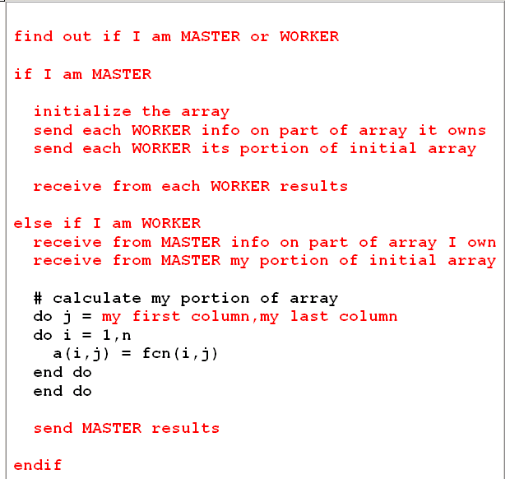
Array Processing Solution 1 One possible implementation

Slide 137
Array Processing Solution 2: Pool of Tasks
The previous array solution demonstrated static load balancing:
Each task has a fixed amount of work to do
May be significant idle time for faster or more lightly loaded processors - slowest tasks determines overall performance.
Static load balancing is not usually a major concern if all tasks are performing the same amount of work on identical machines.
If you have a load balance problem (some tasks work faster than others), you may benefit by using a "pool of tasks" scheme.

Slide 138
Array Processing Solution 2 Pool of Tasks Scheme
Two processes are employed
Master Process:
Holds pool of tasks for worker processes to do
Sends worker a task when requested
Collects results from workers
Worker Process: repeatedly does the following
Gets task from master process
Performs computation
Sends results to master
Worker processes do not know before runtime which portion of array they will handle or how many tasks they will perform.
Dynamic load balancing occurs at run time: the faster tasks will get more work to do.
Pseudo code solution: red highlights changes for parallelism.

Slide 139
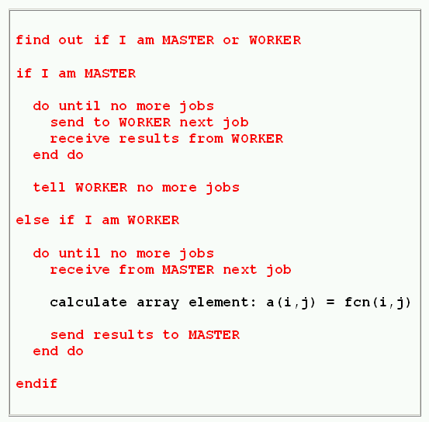
Array Processing Solution 2 Pool of Tasks Scheme

Slide 140
Pi Calculation
The value of PI can be calculated in a number of ways. Consider the following method of approximating PI
Inscribe a circle in a square
Randomly generate points in the square
Determine the number of points in the square that are also in the circle
Let r be the number of points in the circle divided by the number of points in the square
PI ~ 4 r
Note that the more points generated, the better the approximation

Slide 141
Discussion
In the above pool of tasks example, each task calculated an individual array element as a job. The computation to communication ratio is finely granular.
Finely granular solutions incur more communication overhead in order to reduce task idle time.
A more optimal solution might be to distribute more work with each job. The "right" amount of work is problem dependent.

Slide 142
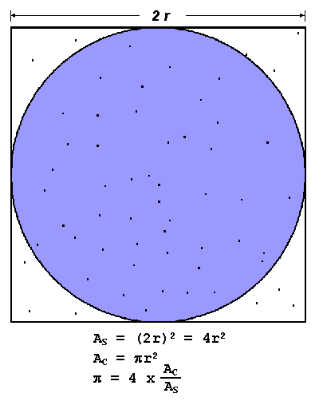
Algorithm
npoints = 10000
circle_count = 0
do j = 1,npoints
generate 2 random numbers between 0 and 1
xcoordinate = random1 ; ycoordinate = random2
if (xcoordinate, ycoordinate) inside circle then circle_count = circle_count + 1
end do
PI = 4.0*circle_count/npoints
Note that most of the time in running this program would be spent executing the loop
Leads to an embarrassingly parallel solution
- Computationally intensive
- Minimal communication
- Minimal I/O

Slide 143
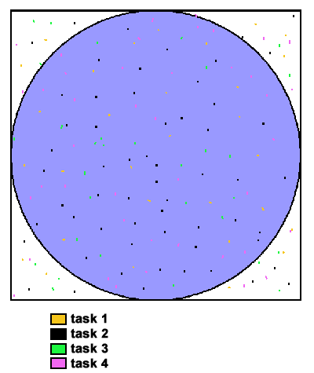
PI Calculation Parallel Solution
Parallel strategy: break the loop into portions that can be executed by the tasks.
For the task of approximating PI:
Each task executes its portion of the loop a number of times.
Each task can do its work without requiring any information from the other tasks (there are no data dependencies).
Uses the SPMD model. One task acts as master and collects the results.
Pseudo code solution: red highlights changes for parallelism.

Slide 144
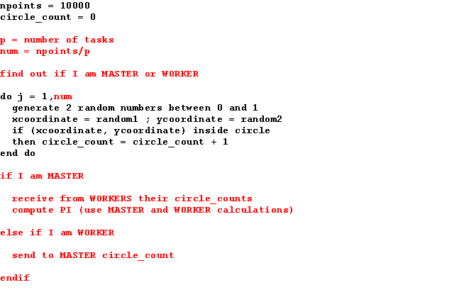
PI Calculation Parallel Solution

Slide 145
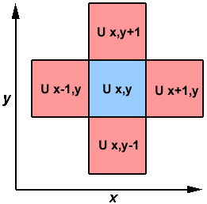
Simple Heat Equation
Most problems in parallel computing require communication among the tasks. A number of common problems require communication with "neighbor" tasks.
The heat equation describes the temperature change over time, given initial temperature distribution and boundary conditions.
A finite differencing scheme is employed to solve the heat equation numerically on a square region.
The initial temperature is zero on the boundaries and high in the middle.
The boundary temperature is held at zero.
For the fully explicit problem, a time stepping algorithm is used. The elements of a 2-dimensional array represent the temperature at points on the square.

Slide 146
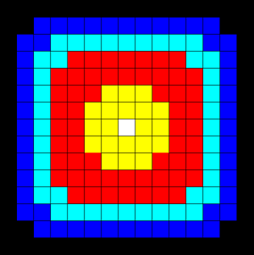
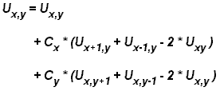
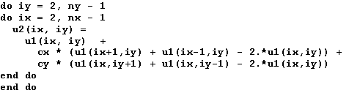
Simple Heat Equation
The calculation of an element is dependent upon neighbor element values.
A serial program would contain code like:

Slide 147
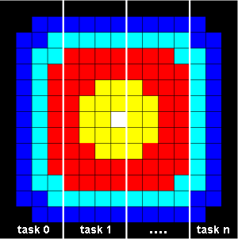
Parallel Solution 1
Implement as an SPMD model
The entire array is partitioned and distributed as subarrays to all tasks. Each task owns a portion of the total array.
Determine data dependencies
interior elements belonging to a task are independent of other tasks
border elements are dependent upon a neighbor task's data, necessitating communication.
Master process sends initial info to workers, checks for convergence and collects results
Worker process calculates solution, communicating as necessary with neighbor processes
Pseudo code solution: red highlights changes for parallelism.

Slide 148
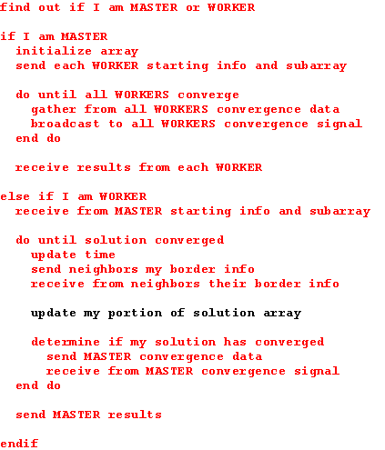
Parallel Solution 1

Slide 149
Parallel Solution 2 Overlapping Communication and Computation
In the previous solution, it was assumed that blocking communications were used by the worker tasks. Blocking communications wait for the communication process to complete before continuing to the next program instruction.
In the previous solution, neighbor tasks communicated border data, then each process updated its portion of the array.
Computing times can often be reduced by using non-blocking communication. Non-blocking communications allow work to be performed while communication is in progress.
Each task could update the interior of its part of the solution array while the communication of border data is occurring, and update its border after communication has completed.
Pseudo code for the second solution: red highlights changes for non-blocking communications.

Slide 150
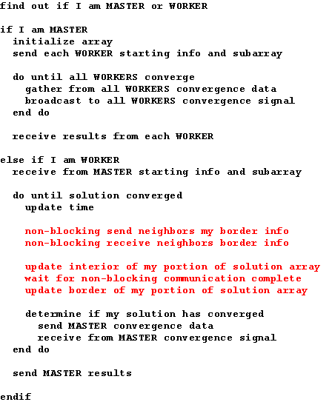
Parallel Solution 2 Overlapping Communication and Computation

Slide 151
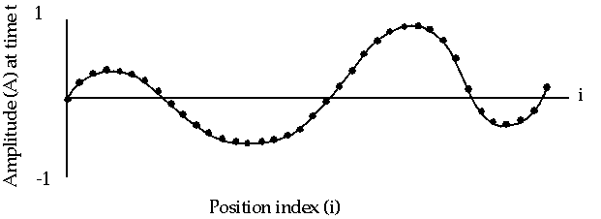
1-D Wave Equation
In this example, the amplitude along a uniform, vibrating string is calculated after a specified amount of time has elapsed.
The calculation involves:
the amplitude on the y axis
i as the position index along the x axis
node points imposed along the string
update of the amplitude at discrete time steps.

Slide 152
1-D Wave Equation
The equation to be solved is the one-dimensional wave equation: where c is a constant
Note that amplitude will depend on previous timesteps (t, t-1) and neighboring points (i-1, i+1). Data dependence will mean that a parallel solution will involve communications.

Slide 153
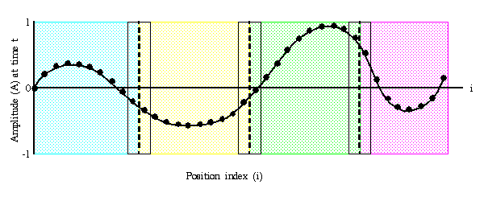
1-D Wave Equation Parallel Solution
Implement as an SPMD model
The entire amplitude array is partitioned and distributed as subarrays to all tasks. Each task owns a portion of the total array.
Load balancing: all points require equal work, so the points should be divided equally
A block decomposition would have the work partitioned into the number of tasks as chunks, allowing each task to own mostly contiguous data points.
Communication need only occur on data borders. The larger the block size the less the communication.

Slide 154
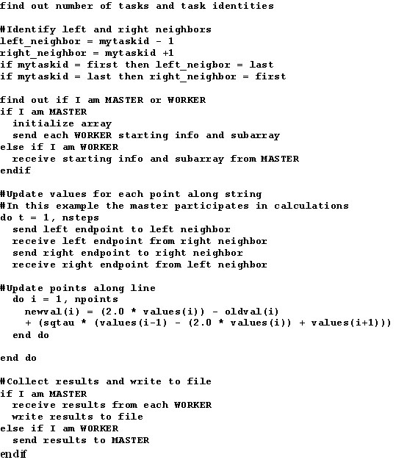
1-D Wave Equation Parallel Solution

Slide 155
This ends this tutorial

